Slide 1
Spring 2013 B609
Circulation with lower bound problem
Hsi-Yun Cheng(hsiychen), Tzu-Feng Wu (tzwu)
April 10, 2013

Slide 2
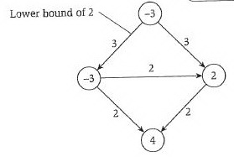
Problem
Demand: d_{v}=f^{in}(v)-f^{out}(v)
Practical example:
  A system of highway lines in which
  we want to ship products from factories (supply) to retail outlets (demand).
Customize footer: View menu/Header and Footer

Slide 3
Implementation
language: C
Data structure: Adjacent list (by linked list)
  Demand (int)
  Capacity (int)
  lower bound (int)
Customize footer: View menu/Header and Footer

Slide 4
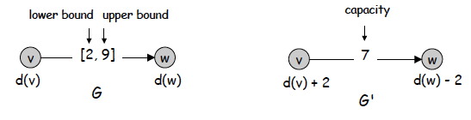
Algorithm
Step 1: eliminate lower bound
Step 2: check whether Σ_{v}d_{v} = 0. If not, there is no solution.
Customize footer: View menu/Header and Footer

Slide 5
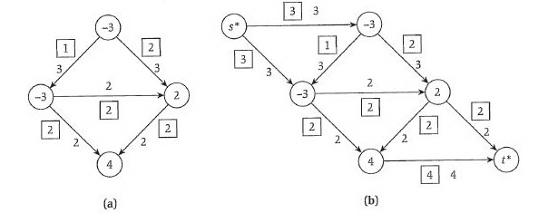
Algorithm
Step 3: add source (s*) and sink(t*) nodes.
Customize footer: View menu/Header and Footer

Slide 6
Algorithm
Step 4: find maximum flow using Ford-Fulkerson Algorithm
  - If Σ_{v:dv>0}d_{v} = value of max flow, this circulation is feasible
Use Ford-Fulkerson Algorithm
  Augmentation
  Finding maximum flow
Customize footer: View menu/Header and Footer

Slide 7

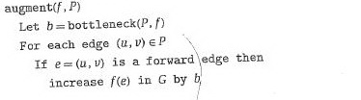
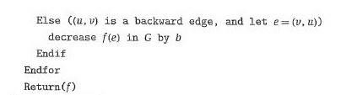
Augmentation
Customize footer: View menu/Header and Footer

Slide 8
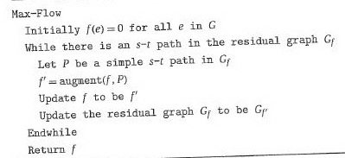
Max-flow
Customize footer: View menu/Header and Footer

Slide 9
Reference
Chapter 7. Algorithm Design, Kleinberg and Tardos.
B609 2013 Spring notes. Tang, H.
Customize footer: View menu/Header and Footer

